Slide 1
CHILDREN’s university
Wellesbourne primary

Slide 2
https://youtu.be/e9Dq-IYzjXs

Slide 3
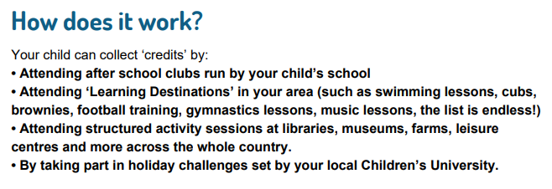
What is CU?

Slide 5
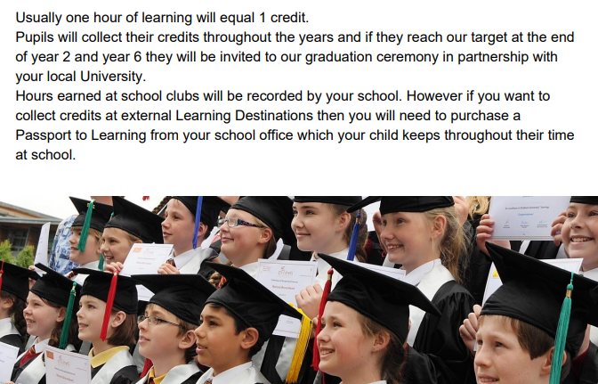

Slide 7
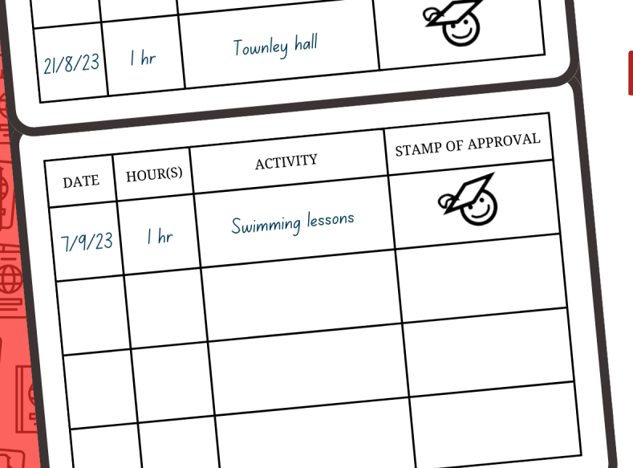

Slide 10
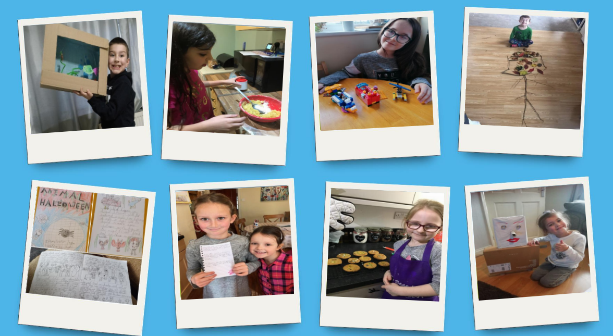

Slide 13
